Slide 1
AZ-400.00 Learning Path 07: Design and implement a dependency management strategy

Slide 2
Module 01: Explore package dependencies

Slide 3
What is dependency management?
1
Modern software is complex
2
Component based development is common
3
Not all software is written by a single team
4
Dependencies on components created by other teams or persons

Slide 4
Describe elements of a dependency management strategy
Standardization
Package formats and sources
Versioning

Slide 5
Identify dependencies
Find components and source code that can have independent:
Things to consider:
Deployment
Release
Versioning
Change frequency
Changes should be unrelated to other parts of system
Can package exist by itself
Package should add value for others

Slide 6
Understand source and package componentization
1
Source componentization:
Split out components
Related projects in different solutions
2
Package componentization:
Composing your solution to use packages

Slide 7
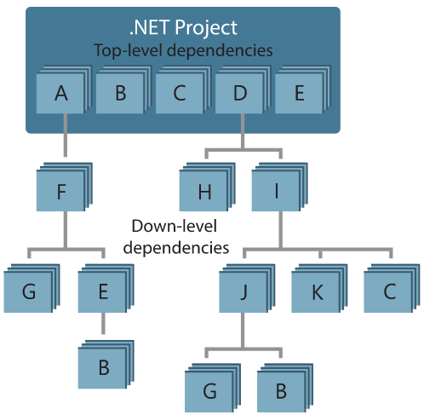
Decompose your system
Approach:
Draw a dependency graph
Group components in sets of related components
Few spanning check-ins across sets
Ideally a single team is responsible
Shared release cadence for single set

Slide 8
Module 02: Understand package management

Slide 9


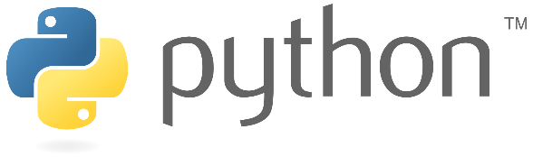

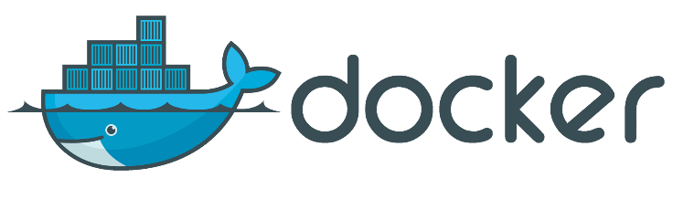
Explore packages
A package is a formalized way of creating a distributable unit of software artifacts that can be consumed from another software solution.
Microsoft platform
and .NET artifacts
Node.js modules
Python modules
Universal packages
Java packages
Docker images

Slide 10
Understand package feeds
Centralized storage of package artifacts:
Public or privately available
Offer secure access for private feeds
Versioned storage of packages
Managed by tooling
Also known as:
Package repositories
Package registry
Package types:
Public: NuGet.org, Npmjs.org, PyPi.org, Docker Hub
Private: MyGet, Azure Container Registry, Azure Artifacts, Self-hosted solutions

Slide 11
Explore package feed managers
1
Manage feeds
2
Search and list packages from feed
3
Consume packages
4
Maintain local installation cache
5
Publish packages
6
Choose tooling:
Command-line tooling
Integrated in build and release pipelines

Slide 12
Explore common public package sources
NuGet Gallery
https://nuget.org
NPMjs
https://npmjs.org
Maven
https://search.maven.org
Docker Hub
https://hub.docker.com
Python Package Index
https://pypi.org

Slide 13
Explore self-hosted and SaaS based package sources
Package type | Self-hosted private feed | SaaS private feed
NuGet | NuGet server | Azure Artifacts, MyGet, GitHub Packages
NPM | Sinopia, cnpmjs.org, Verdaccio | NPMjs.org, MyGet, Azure Artifacts, GitHub Packages
Maven | Nexus, Artifactory, Archiva | Azure Artifacts, Bintray, JitPack, GitHub Packages
Docker | Portus, Quay, Harbor | Docker Hub, Azure Container Registry, Amazon Elastic Container Registry
Python | PyPI Server | Azure Artifacts, Gemfury

Slide 14
Consume packages
1
Identify a required dependency in your codebase
2
Find a component that satisfies the requirements for the project
3
Search the package sources for a package offering a correct version of the component
4
Install the package into the codebase and development machine
5
Create the software implementation that uses the new components from the package

Slide 15

Introduction to Azure Artifacts
Create private and public package feeds for package types:
NuGet
NPM
Maven
Universal
Python
Azure Artifacts

Slide 16
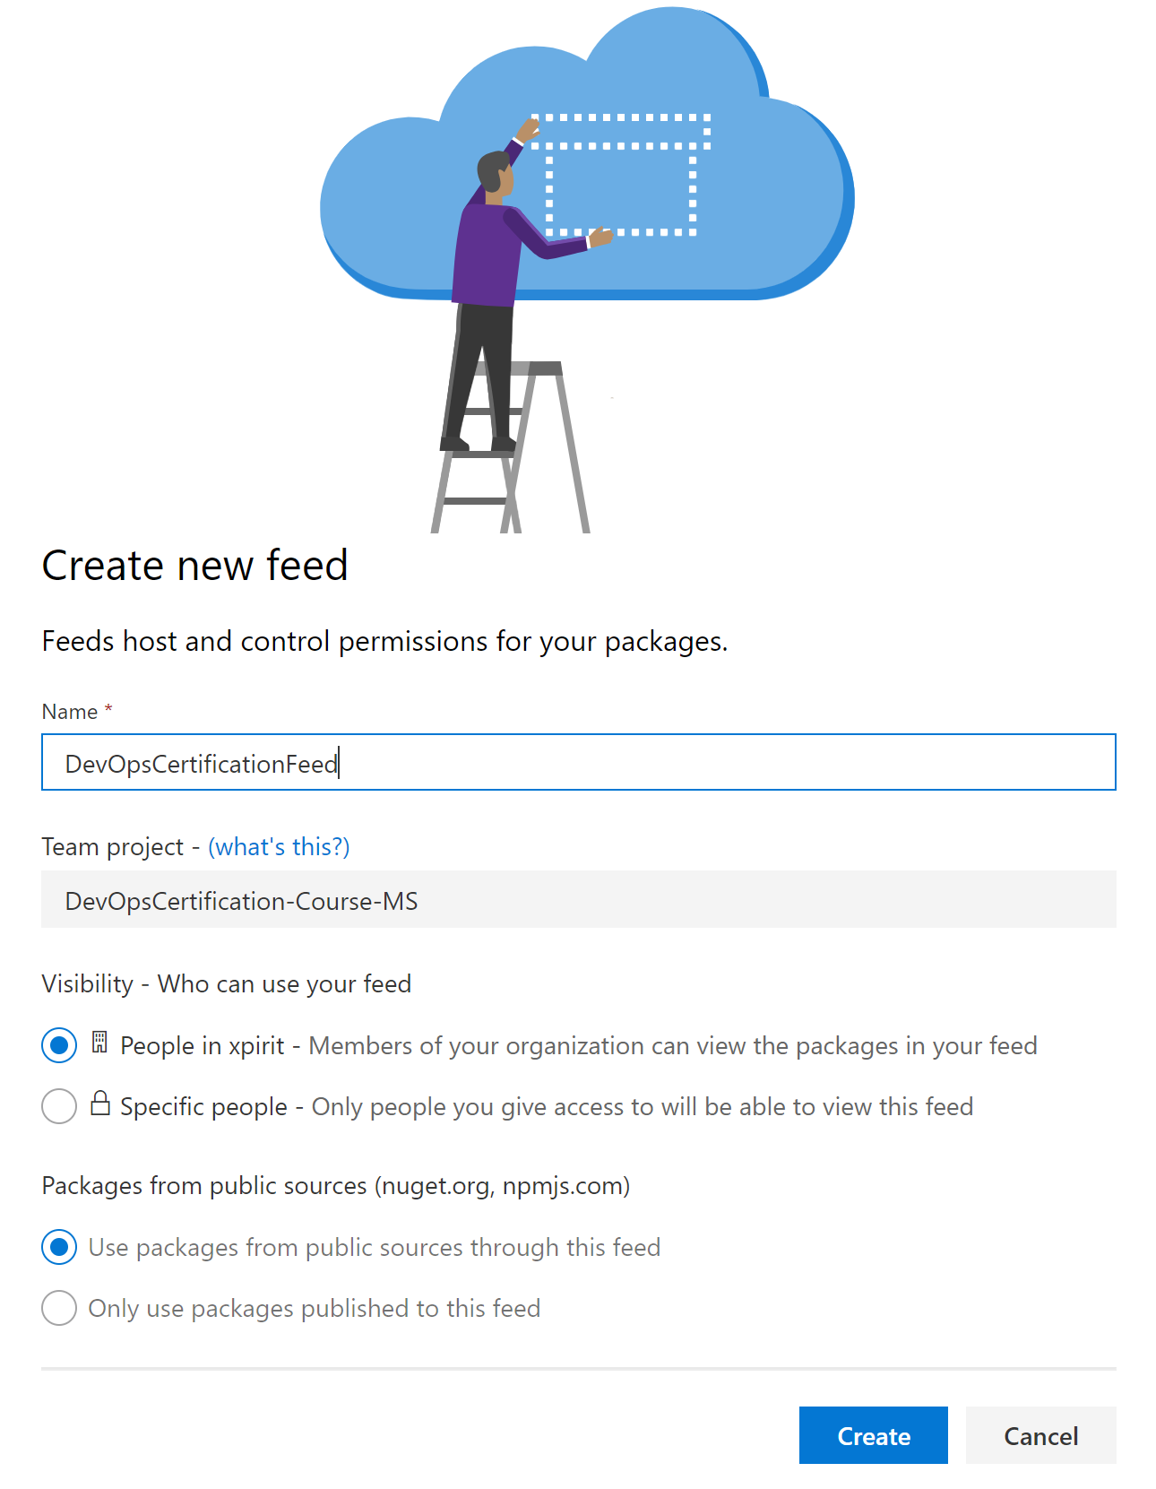
Publish packages
From Azure DevOps portal
Feeds are centralized
Specify:
Name
Visibility
Public sources as upstream

Slide 17
Module 04: Implement a versioning strategy

Slide 18
Introduction to versioning
1
Packages need to be versioned
Identification
Maintainability
Each package has its own lifecycle and rate of change
2
Packages are immutable
Once published a package cannot be changed
Replacing or updating a package is not allowed
Any change requires a new version

Slide 19
Understand versioning of artifacts
Way to express version technically varies per package type
Versioning requires a scheme
Typical Scheme:
2.1.15
Major
Minor
Patch

Slide 20
Explore semantic versioning
Express nature and risk of change
1.2.3
-beta2
Nature of change
Quality of change
See also: https://semver.org

Slide 21
Examine release views
Views help in defining quality without changing version numbers
Three default views:
1
2
3
Local
Prerelease
Release
https://pkgs.dev.azure.com/{org}/{yourteamproject}/_packaging/{feedname} @{Viewname}/nuget/v3/index.json

Slide 22
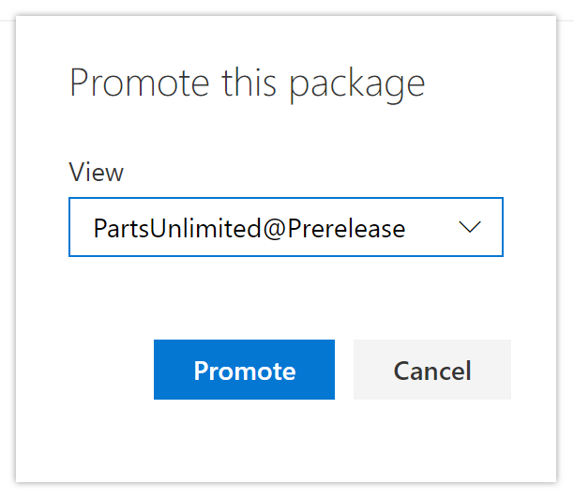
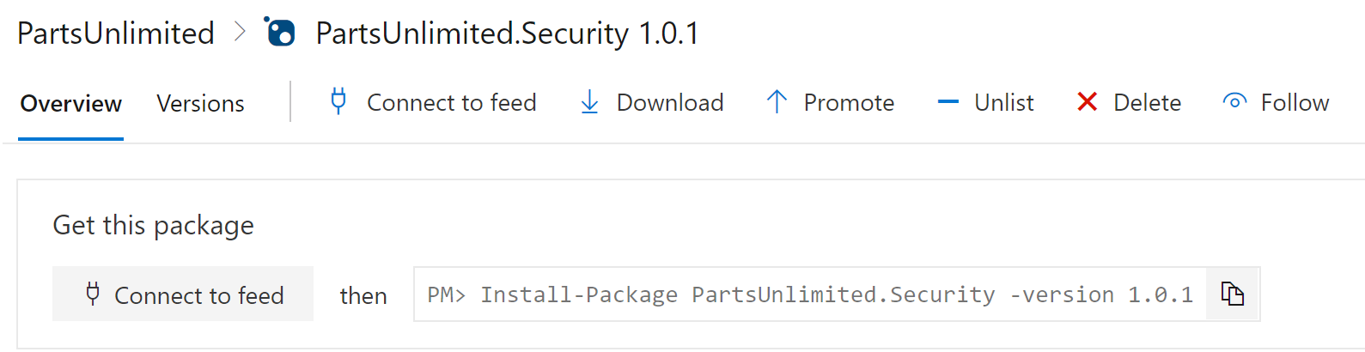
Promote packages
Promote packages from @local view to other release views.
Upstream sources will only be evaluated from @local view:
Only visible in other release views after being promoted

Slide 23
Explore best practices for versioning
1
Have a documented versioning strategy
2
Adopt SemVer 2.0 for your versioning scheme
3
Each repository should only reference one feed
4
On package creation, automatically publish packages back to the feed

